Slide 1
The Final Project
🏆
Ready.....Set....Go!

Slide 2

Objectives
Use skills from throughout the course to create a piece of software you are proud of
Learn how to manage a project
Learn how to troubleshoot and find resources online
Have Fun!

Slide 3

Skills
Data Types - String, int, char, boolean, Arrays
Program Flow - if statement, switch statement, while loop, for loop
Variables
Methods
Libraries

Slide 4
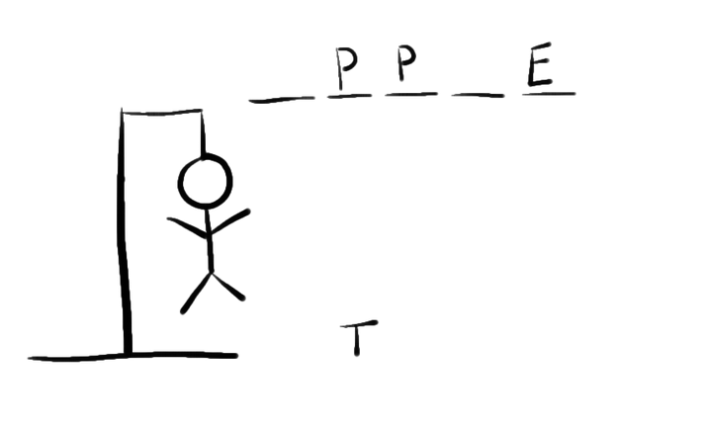
Project Description
You are going to create a hangman game you can play in the java console.
For those who don’t know hangman
http://www.hangman.no/
Examples:
https://gist.github.com/leahloughran/2722645
https://www.youtube.com/watch?v=NnE5M80i9yo
There are few requirements for this project, so you will
have to be pretty independent. Of course, we will help
you along. :D.

Slide 5
Project Requirements
Be able to play a full game of hangman (2 player)
One player enters a word and the other guesses
The program must get guesses, and kept track of which guesses have been made, which have been right (filling in blanks), and how many have been wrong (the hangman).
You can do this in many different ways, you programs will be unique
Ex: Guesses wrong: XXX or an actual ascii art picture printed to the console
You decide....

Slide 6
Steps
Plan your project - What do you want the program to look like. How are you prompting and responding. (On paper)
Write pseudo code - What are the steps the program will have to go through (In Eclipse using comments)
Write actual program
If you are stuck, search on google for your problem, then if you can’t get it ask us
Some good websites are tutorialspoint, oracle java docs, stack overflow
LET’S GET STARTED!

